Slide 1
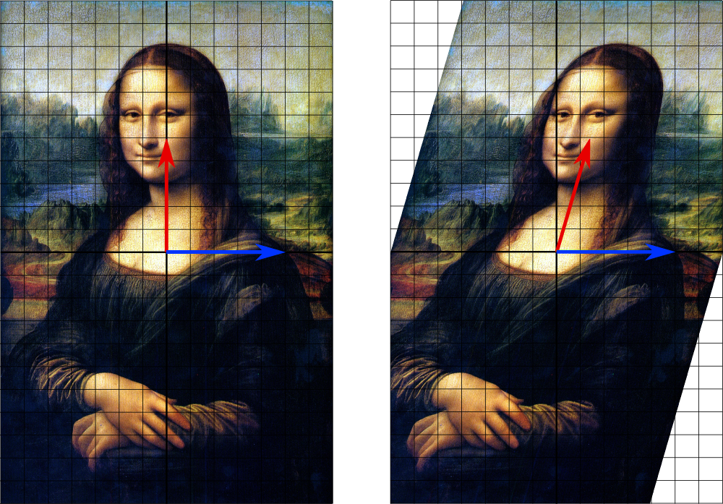
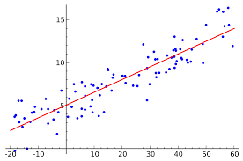
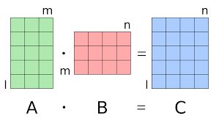
Near Optimal Linear Algebra in the Online and Sliding Window Models
1 0 1 1 1 0 0 1 1 0 1

Slide 2

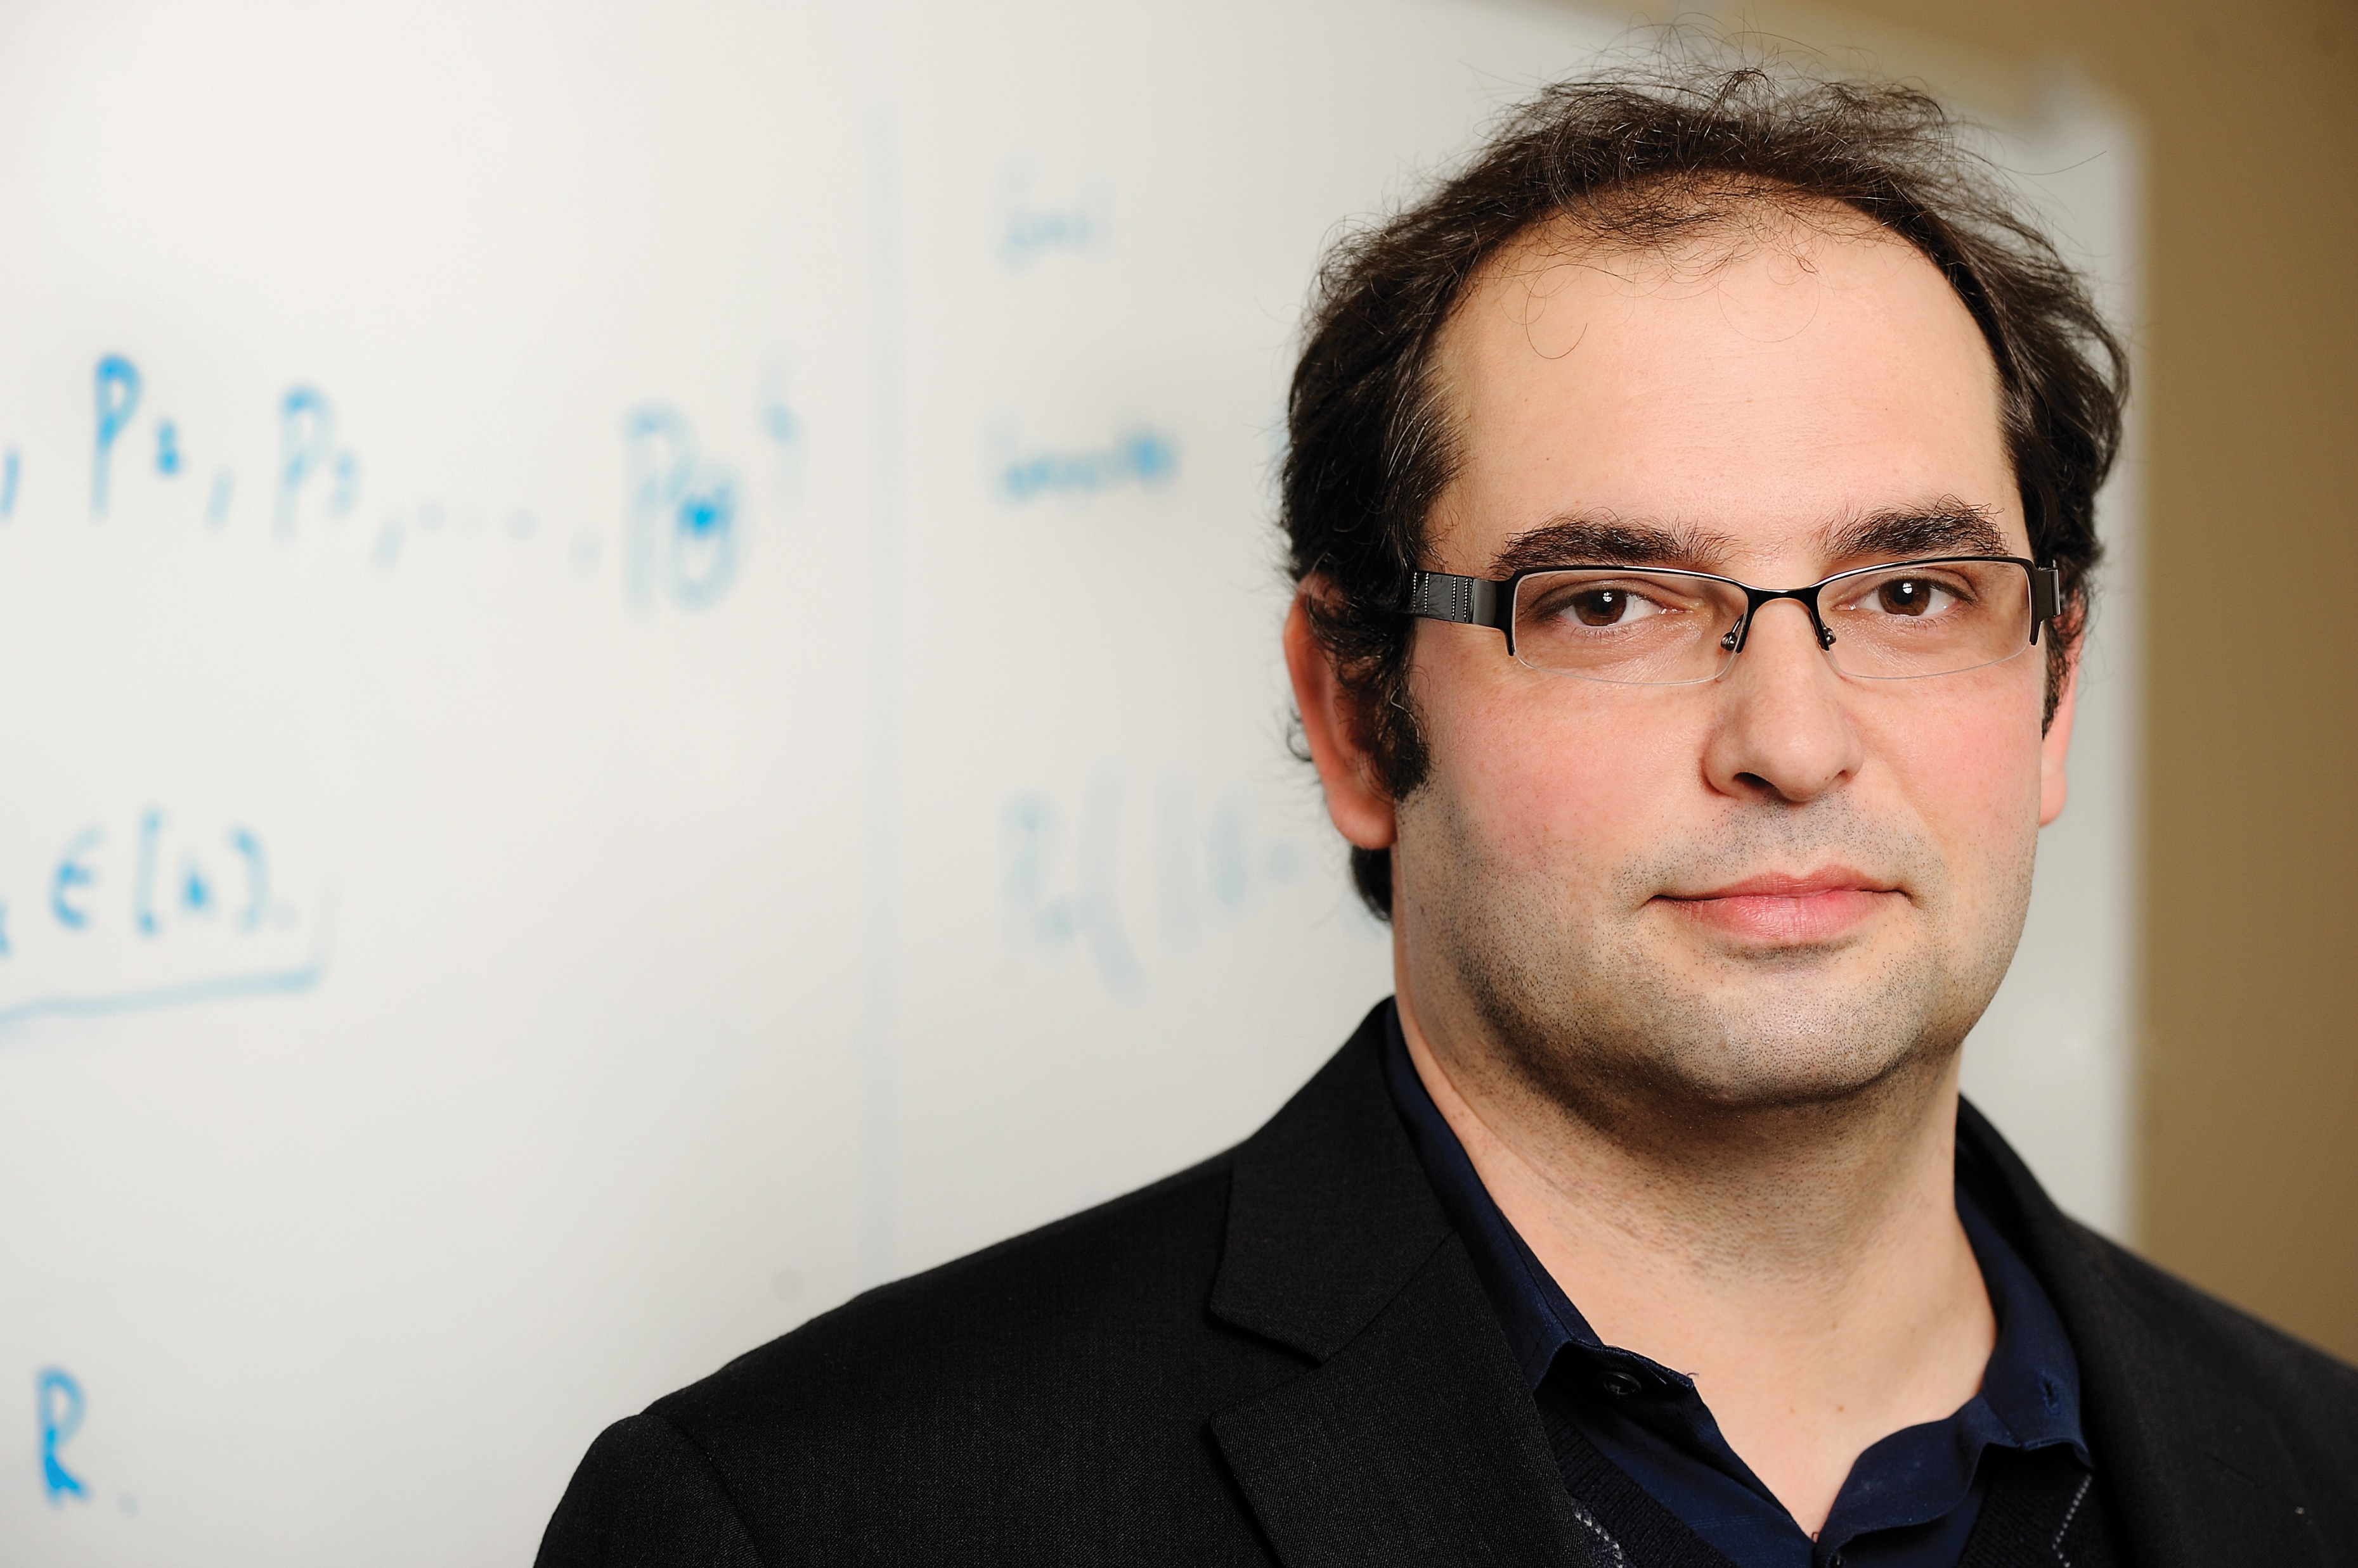


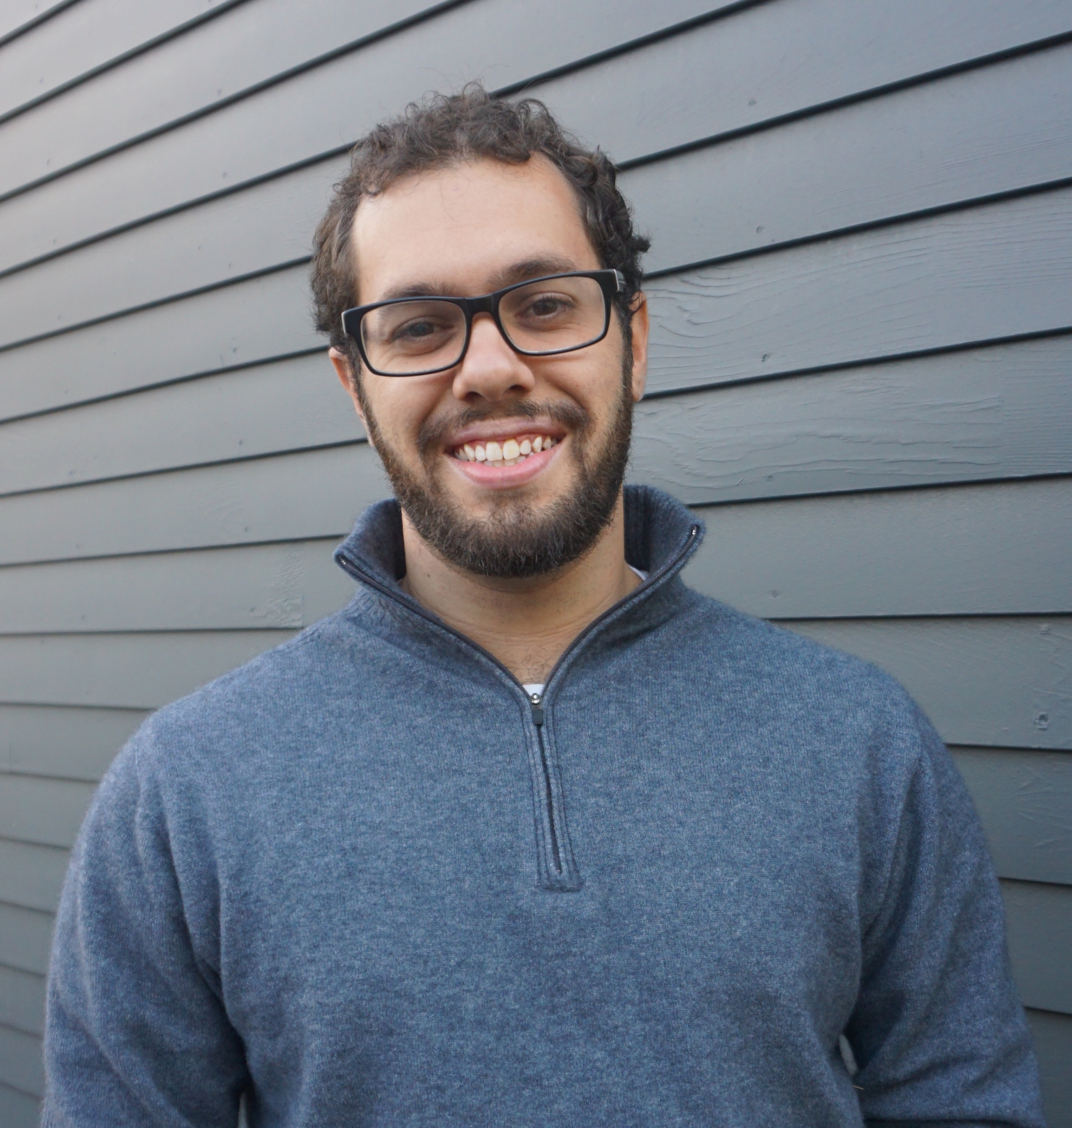

Vladimir Braverman
Petros Drineas
Cameron Musco

Slide 3







Christopher Musco
Jalaj Upadhyay
David P. Woodruff
Samson Zhou

Slide 4
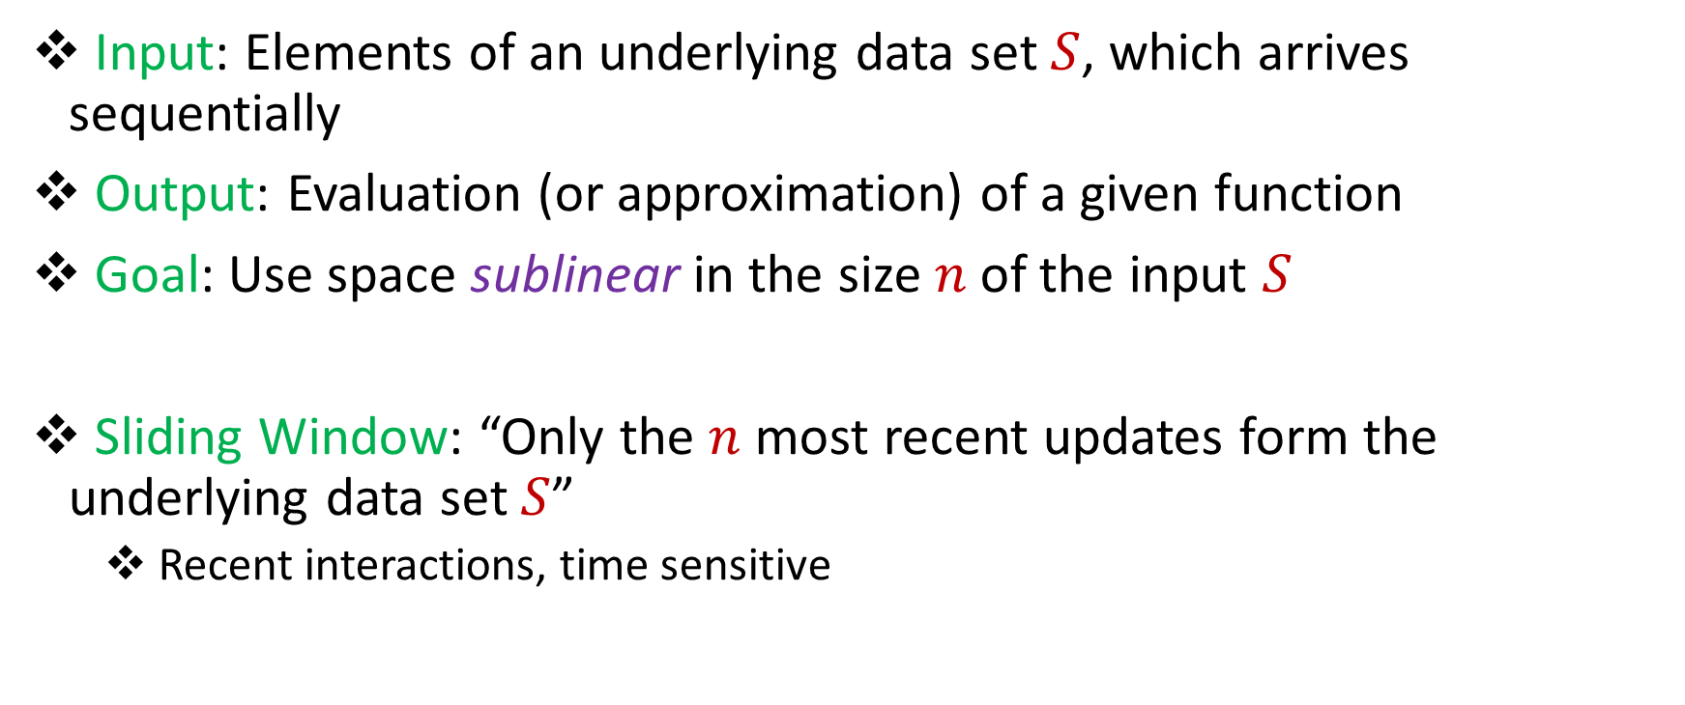
Model #1: Sliding Window Model
Input: Elements of an underlying data set $S$, which arrives sequentially
Output: Evaluation (or approximation) of a given function
Goal: Use space sublinear in the size $n$of the input $S$
Sliding Window: “Only the $n$ most recent updates form the underlying data set $S$”
Recent interactions, time sensitive
1 0 1 1 1 0 0 1 1 0 1
Notes:
Let’s start by breaking down each of the terms in the title. To understand the sliding window model, we first have to understand the streaming model of computation, in which elements of an underlying data set S, arrive sequentially and the goal is to evaluate or approximate some given function on this dataset, using space sublinear in S. In the sliding window model, only the W most recent updates form the underlying data set. The sliding window model emphasizes recent data and thus is appropriate for settings that are time sensitive.

Slide 5
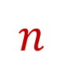
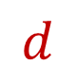
Randomized Numerical Linear Algebra (randNLA) on Sliding Windows
1 3 5 -2 7 0 11 4 -8
0 0 -1 3 13 2 8 6 2
2 5 6 1 4 0 -7 5 3
8 7 2 1 -1 -3 -2 -4 -6
-5 3 -4 -1 -2 -1 0 -3 -1
7 1 3 2 4 1 0 11 1
Rows arrive one-by-one in the data stream
$$n$$
$$d$$
Notes:
Although there’s a number of different streaming update models, in this talk we’ll focus on the row arrival model, where we gets rows of a matrix one at a time.

Slide 6
Randomized Numerical Linear Algebra (randNLA) on Sliding Windows
1 3 5 -2 7 0 11 4 -8
0 0 -1 3 13 2 8 6 2
2 5 6 1 4 0 -7 5 3
8 7 2 1 -1 -3 -2 -4 -6
-5 3 -4 -1 -2 -1 0 -3 -1
7 1 3 2 4 1 0 11 1
1 2 5 -5 4 1 23 4 -3
Rows arrive one-by-one in the data stream
$$n$$
$$d$$

Slide 7
Randomized Numerical Linear Algebra (randNLA) on Sliding Windows
1 3 5 -2 7 0 11 4 -8
0 0 -1 3 13 2 8 6 2
2 5 6 1 4 0 -7 5 3
8 7 2 1 -1 -3 -2 -4 -6
-5 3 -4 -1 -2 -1 0 -3 -1
7 1 3 2 4 1 0 11 1
1 2 5 -5 4 1 23 4 -3
0 5 0 0 7 0 1 31 6
Rows arrive one-by-one in the data stream
$$n$$
$$d$$

Slide 8
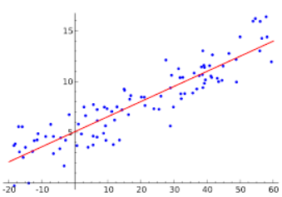
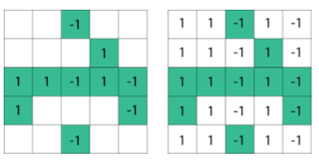
Why randNLA on Sliding Windows?
Sliding window emphasizes efficiency and recency, good for massive data sources and time-sensitive information
We use linear algebra in optimization strategies and prediction of future patterns based on past data, don’t want outdated information
Principal Component Analysis (PCA), Low-Rank Approximation (LRA), Regression
Notes:
As I mentioned, sliding window is a good model for time-sensitive information. We already use tools from linear algebra in applications that are based on optimizing strategies and predicting future patterns based on past data, but we also don’t want to use information that is outdated, so it seems like a natural idea to study numerical linear algebra in the sliding window model.

Slide 9
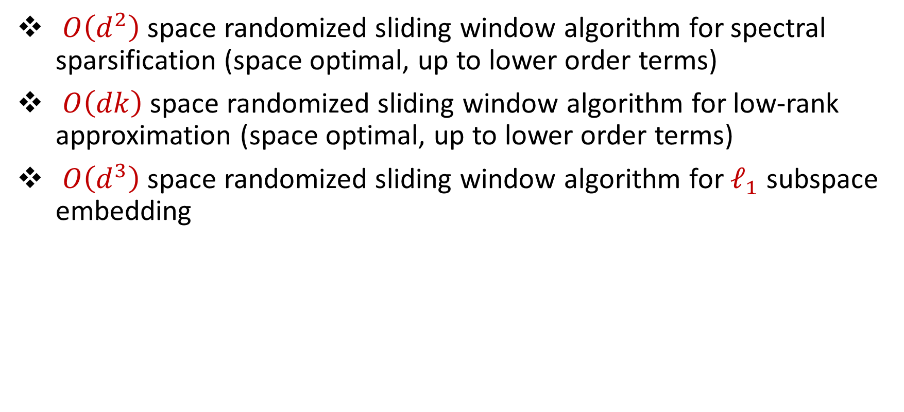
Results: Sliding Window Model
$O\left(d^{2}\right)$space randomized sliding window algorithm for spectral sparsification (space optimal, up to lower order terms)
$O\left(dk\right)$space randomized sliding window algorithm for low-rank approximation (space optimal, up to lower order terms)
$O\left(d^{3}\right)$space randomized sliding window algorithm for $ℓ_{1}$ subspace embedding
Notes:
In this talk, we’ll focus on a space-optimal algorithm for spectral sparsification and then I’ll talk about how to modify the algorithm to get a space-optimal algorithm for low-rank approximation. Before I begin though, I’d like to advertise some other results in this work that I think are really interesting. We also get a deterministic algorithm for spectral sparsification. That’s not space optimal like the randomized algorithm but it presents a natural way of thinking about this problem that is a generalization of smooth histogram framework. We also get sliding window algorithms for L1 subspace embedding with bit complexity assumptions as well as matrix multiplication. Finally, we obtain a number of algorithms for numerical linear algebra in the online setting, which is a cool model that the next speaker will talk about.

Slide 10
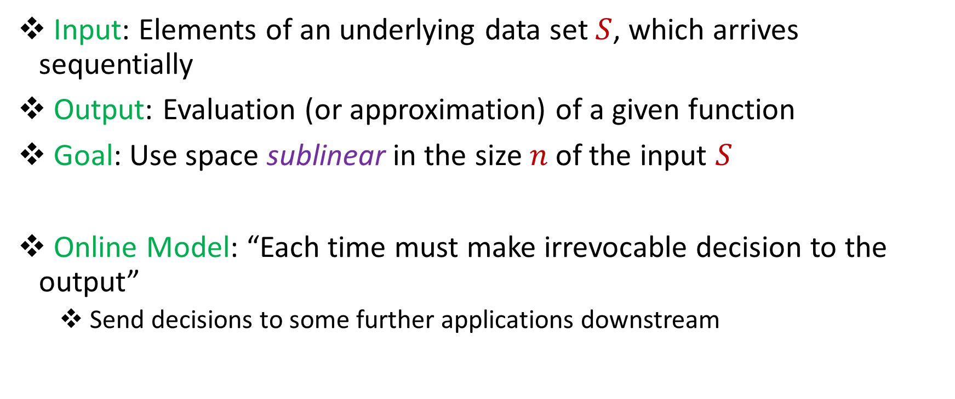
Model #2: Online Model
Input: Elements of an underlying data set $S$, which arrives sequentially
Output: Evaluation (or approximation) of a given function
Goal: Use space sublinear in the size $n$of the input $S$
Online Model: “Each time must make irrevocable decision to the output”
Send decisions to some further applications downstream

Slide 11
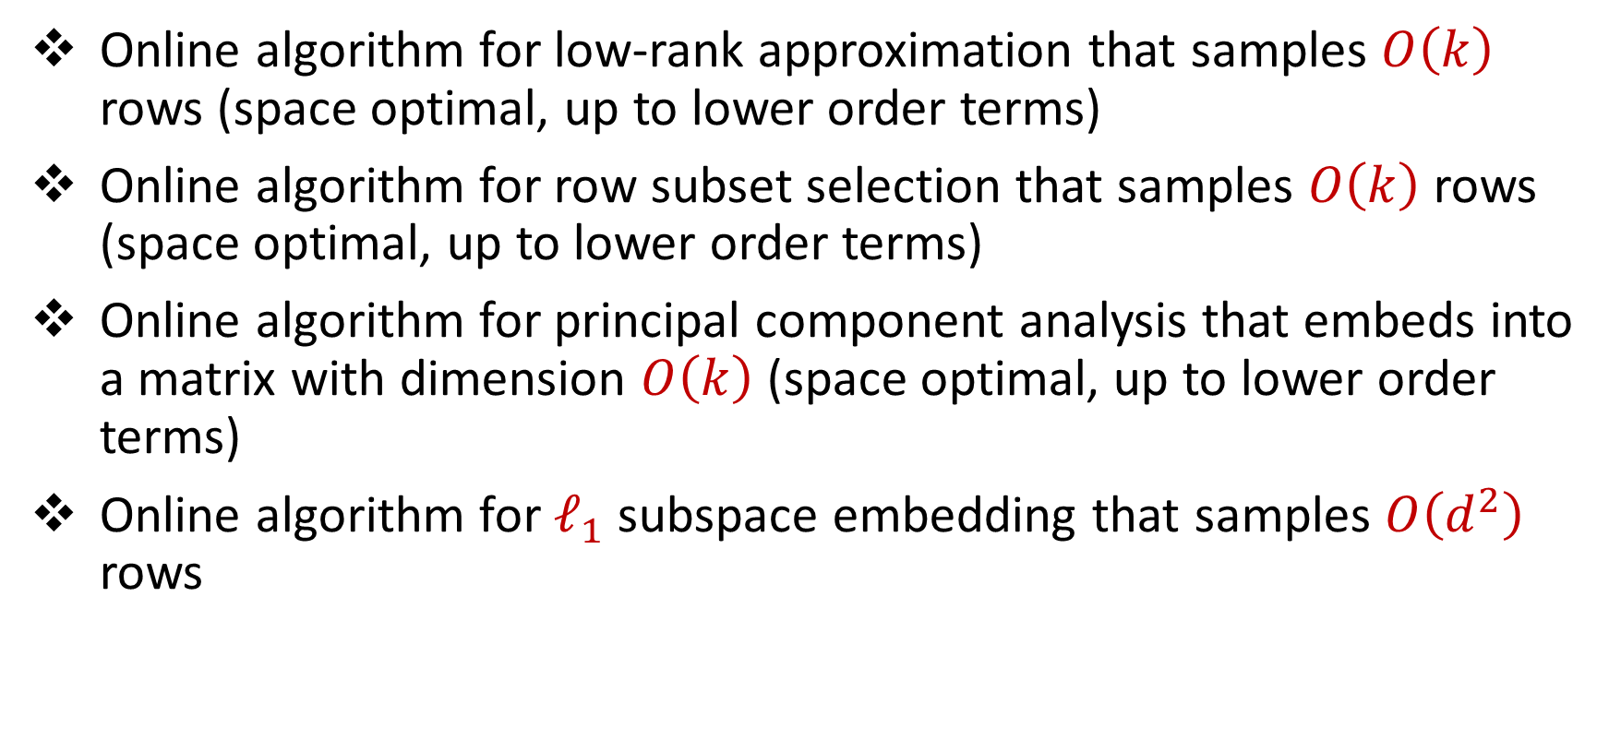
Results: Online Model
Online algorithm for low-rank approximation that samples $O\left(k\right)$ rows (space optimal, up to lower order terms)
Online algorithm for row subset selection that samples $O\left(k\right)$ rows (space optimal, up to lower order terms)
Online algorithm for principal component analysis that embeds into a matrix with dimension $O\left(k\right)$ (space optimal, up to lower order terms)
Online algorithm for $ℓ_{1}$ subspace embedding that samples $O\left(d^{2}\right)$ rows

Slide 12
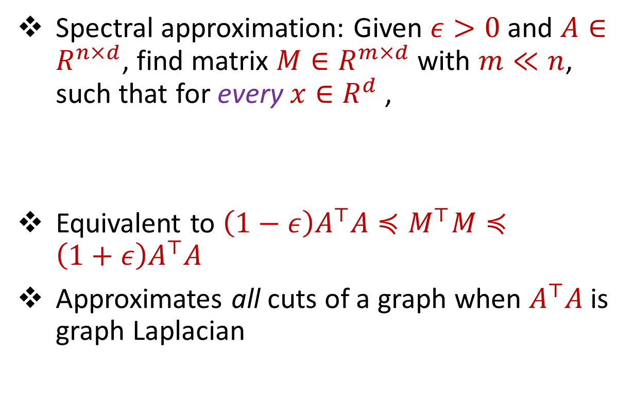
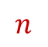
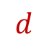
Spectral Sparsification
Spectral approximation: Given $ε>0$ and $A∈R^{n×d}$, find matrix $M∈R^{m×d}$ with $m≪n$, such that for every $x∈R^{d}$,
Equivalent to $\left(1−ε\right)A^{⊤}A≼M^{⊤}M≼\left(1+ε\right)A^{⊤}A$
Approximates all cuts of a graph when $A^{⊤}A$ is graph Laplacian
$$A$$
$$x$$
$$n$$
$$\left(1−ε\right){\left\|Ax\right\|}_{2}≤{\left\|Mx\right\|}_{2}≤\left(1+ε\right){\left\|Ax\right\|}_{2}$$
$$d$$

Slide 13
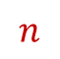
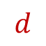
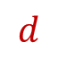
Linear Regression
Find the vector $x$ that minimizes ${\left\|Ax−b\right\|}_{2}$
“Least squares” optimization
$$d$$
$$x$$
$$≈$$
$$n$$
$$A$$
$$n$$
$$b$$
$$1$$
$$d$$
$$1$$

Slide 14
Challenges
Approach 1: Use smooth histogram [BO07] technique for sliding windows
…Functions are not smooth
Approach 2: Use sketching techniques for subspace embeddings
…Cannot undue expirations from sliding window
-2 7 0 11 4 -8
3 13 2 8 6 2
1 4 0 -7 5 3
1 -1 -3 -2 -4 -6
-1 -2 -1 0 -3 -1
2 4 1 0 11 1
$$P$$
$$A$$

Slide 15
Challenges
Approach 1: Use smooth histogram [BO07] technique for sliding windows
…Functions are not smooth
Approach 2: Use sketching techniques for subspace embeddings
…Cannot undue expirations from sliding window
-2 7 0 11 4 -8
3 13 2 8 6 2
1 4 0 -7 5 3
1 -1 -3 -2 -4 -6
-1 -2 -1 0 -3 -1
2 4 1 0 11 1
5 0 4 1 0 -11
$$P$$
$$A$$

Slide 16
Challenges
Approach 1: Use smooth histogram [BO07] technique for sliding windows
…Functions are not smooth
Approach 2: Use sketching techniques for subspace embeddings
…Cannot undue expirations from sliding window
Approach 3: Use sampling techniques for data streams, e.g., sample rows that are important
…Recent rows seem to be more important
-2 7 0 11 4 -8
3 13 2 8 6 2
1 4 0 -7 5 3
1 -1 -3 -2 -4 -6
-1 -2 -1 0 -3 -1
2 4 1 0 11 1
5 0 4 1 0 -11
$$P$$
$$A$$

Slide 17
Challenges
$r_{3}$ does not look important, so we do not sample $r_{3}$
1 3 5 -2 7 0 11 4 -8
0 0 0 0 0 0 0 0 100
0 0 0 0 0 0 0 0 1

Slide 18
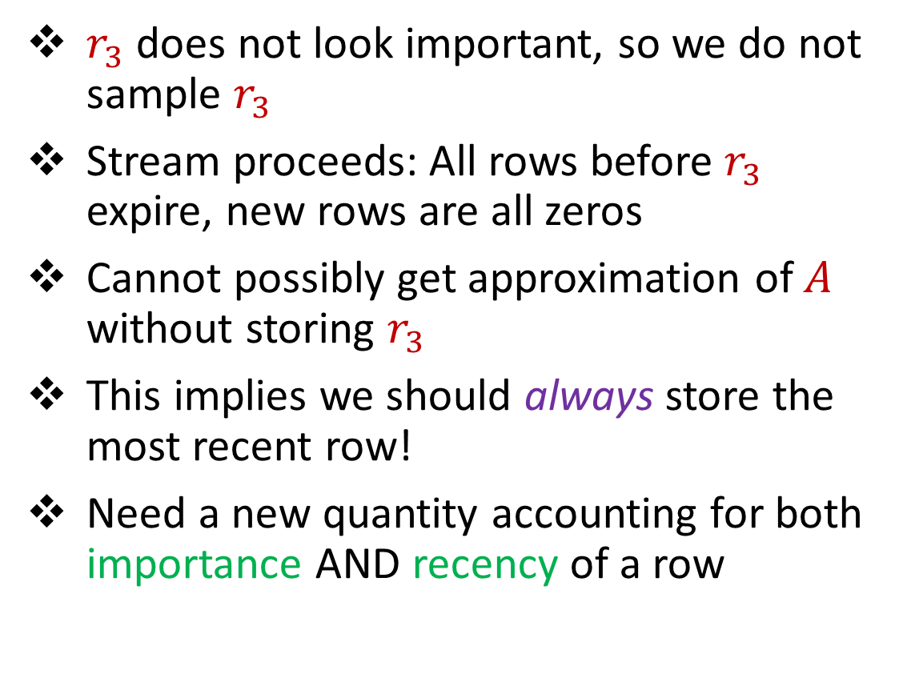
Challenges
$r_{3}$ does not look important, so we do not sample $r_{3}$
Stream proceeds: All rows before $r_{3}$ expire, new rows are all zeros
Cannot possibly get approximation of $A$ without storing $r_{3}$
This implies we should always store the most recent row!
Need a new quantity accounting for both importance AND recency of a row
1 3 5 -2 7 0 11 4 -8
0 0 0 0 0 0 0 0 100
0 0 0 0 0 0 0 0 1
0 0 0 0 0 0 0 0 0
0 0 0 0 0 0 0 0 0
0 0 0 0 0 0 0 0 0
0 0 0 0 0 0 0 0 0
0 0 0 0 0 0 0 0 0

Slide 19
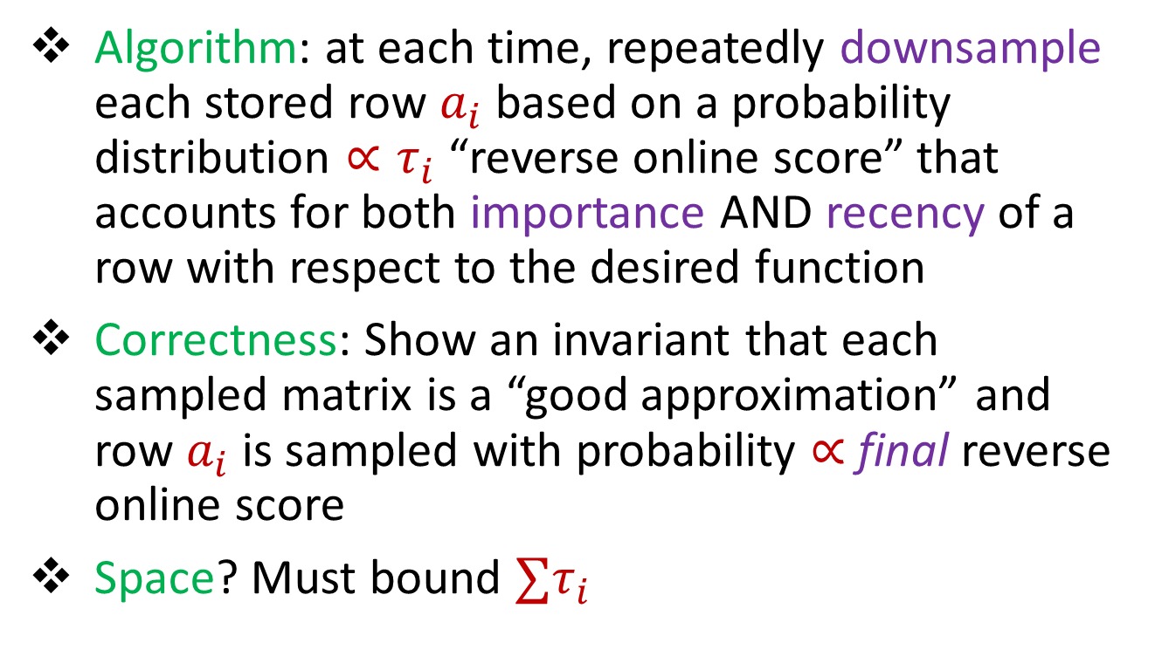
Algorithmic Template (Sliding Windows)
Algorithm: at each time, repeatedly downsample each stored row $a_{i}$based on a probability distribution ${∝τ}_{i}$ “reverse online score” that accounts for both importance AND recency of a row with respect to the desired function
Correctness: Show an invariant that each sampled matrix is a “good approximation” and row $a_{i}$is sampled with probability $∝$ final reverse online score
Space? Must bound ${∑τ}_{i}$
$$A$$

Slide 20
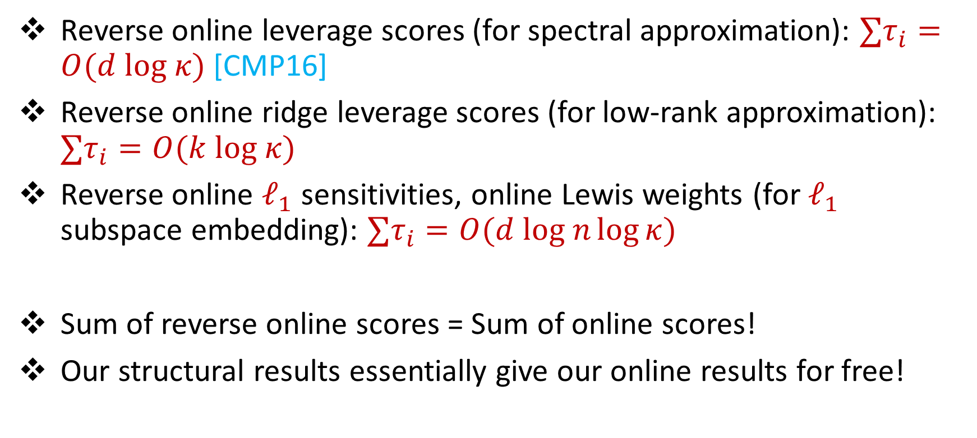
Structural Results for Reverse Online Scores
Reverse online leverage scores (for spectral approximation): ${∑τ}_{i}=O(d log κ)$ [CMP16]
Reverse online ridge leverage scores (for low-rank approximation): ${∑τ}_{i}=O(k log κ)$
Reverse online $ℓ_{1}$ sensitivities, online Lewis weights (for $ℓ_{1}$ subspace embedding): ${∑τ}_{i}=O(d log n\log{κ})$
Sum of reverse online scores = Sum of online scores!
Our structural results essentially give our online results for free!

Slide 21
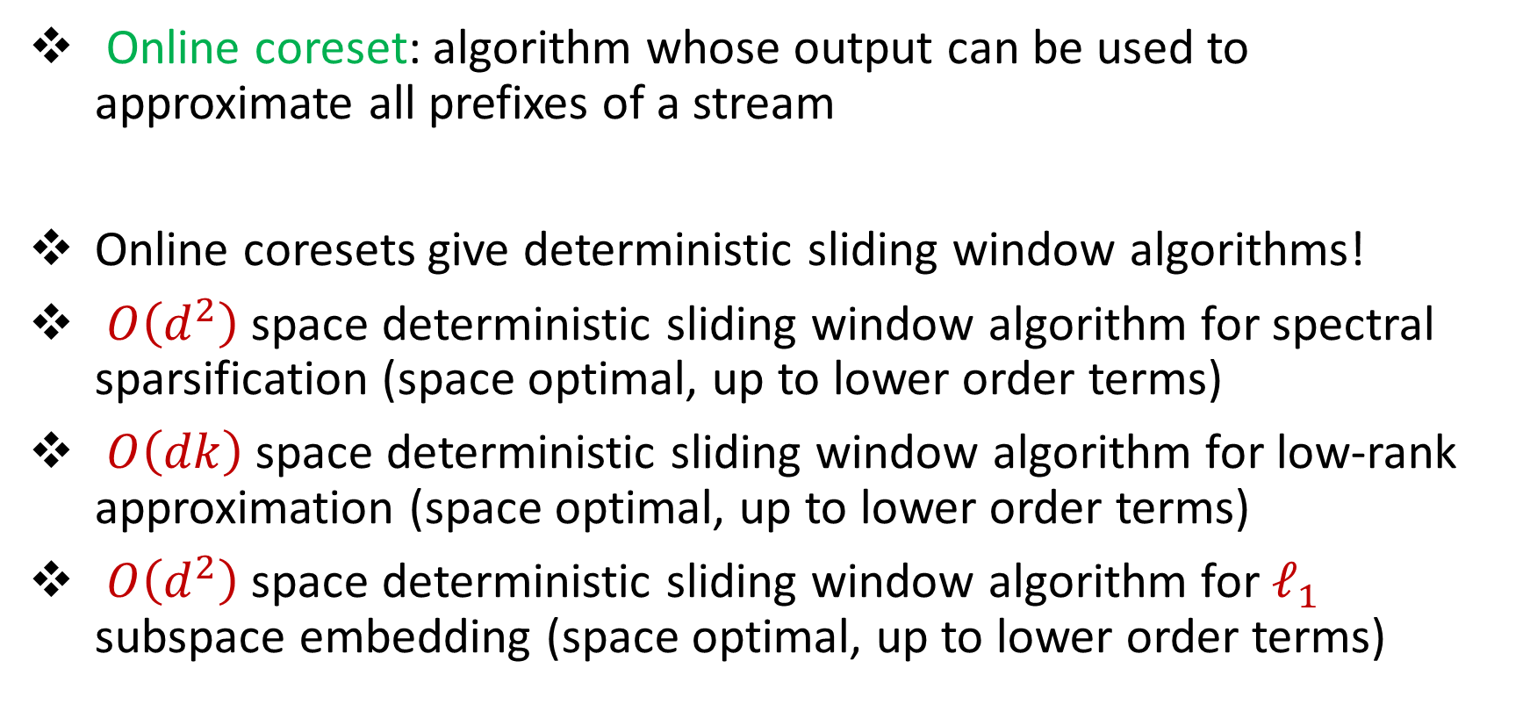
Results: Connections
Online coreset: algorithm whose output can be used to approximate all prefixes of a stream
Online coresets give deterministic sliding window algorithms!
$O\left(d^{2}\right)$space deterministic sliding window algorithm for spectral sparsification (space optimal, up to lower order terms)
$O\left(dk\right)$space deterministic sliding window algorithm for low-rank approximation (space optimal, up to lower order terms)
$O\left(d^{2}\right)$space deterministic sliding window algorithm for $ℓ_{1}$ subspace embedding (space optimal, up to lower order terms)

Slide 22


